Slide 1
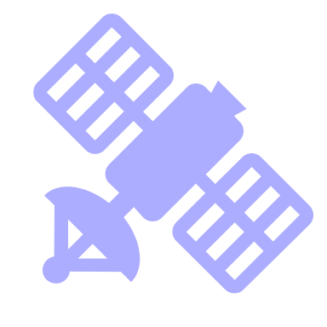
Remote Sensing Natura 2000 area’s
Michael de Winter
Data Scientist

Slide 2



Background
Purpose
Satellite imagery and machine learning
Product

Slide 3
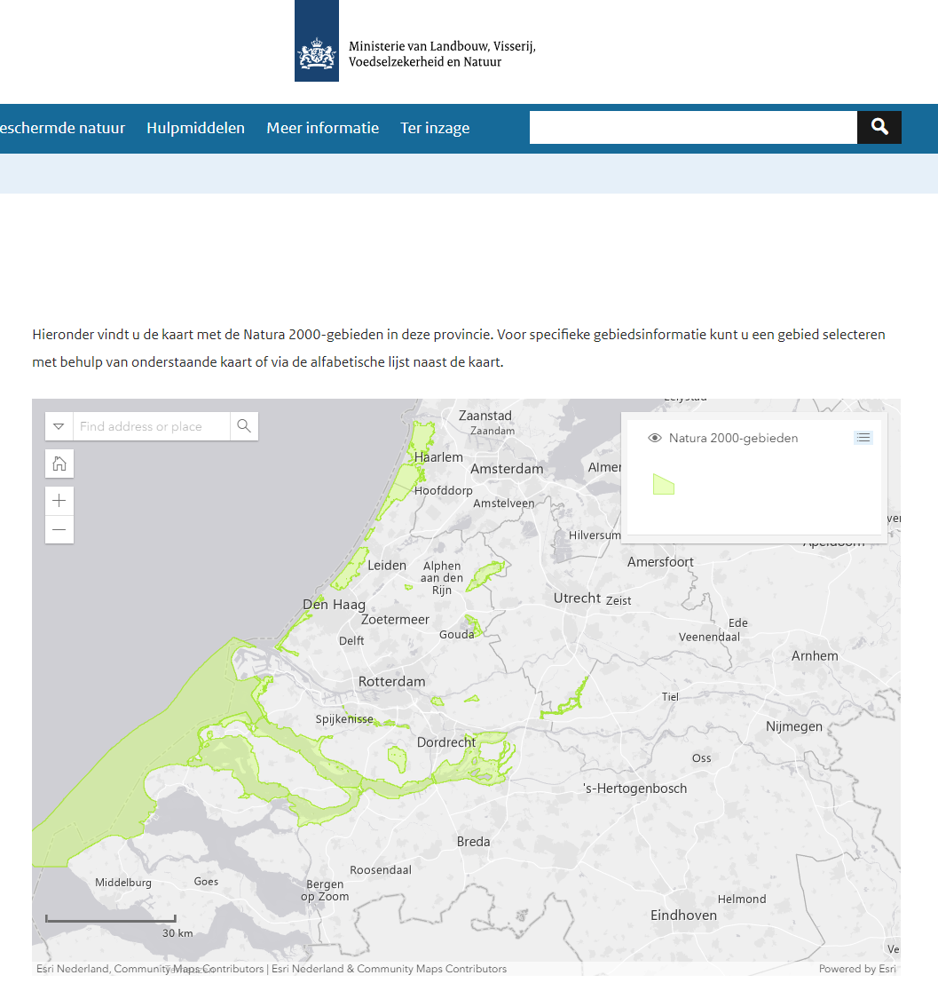
Natura-2000 area’s
Background
Purpose
Natura 2000
A European network of protected nature areas.
Aimed at preserving biodiversity and habitats.
Protects vulnerable species and natural ecosystems.
Based on the Birds Directive and Habitats Directive.
Focuses on sustainable coexistence of nature and human activities.
Role of the Province in Managing Natura 2000 Areas
Develop and implement conservation strategies.
Monitor compliance with nature protection laws.
Permit Granting.
Lead habitat and ecosystem recovery projects.
Balancing Interests
Monitoring biodiversity, track ecological conditions and report to the EU.

Slide 4
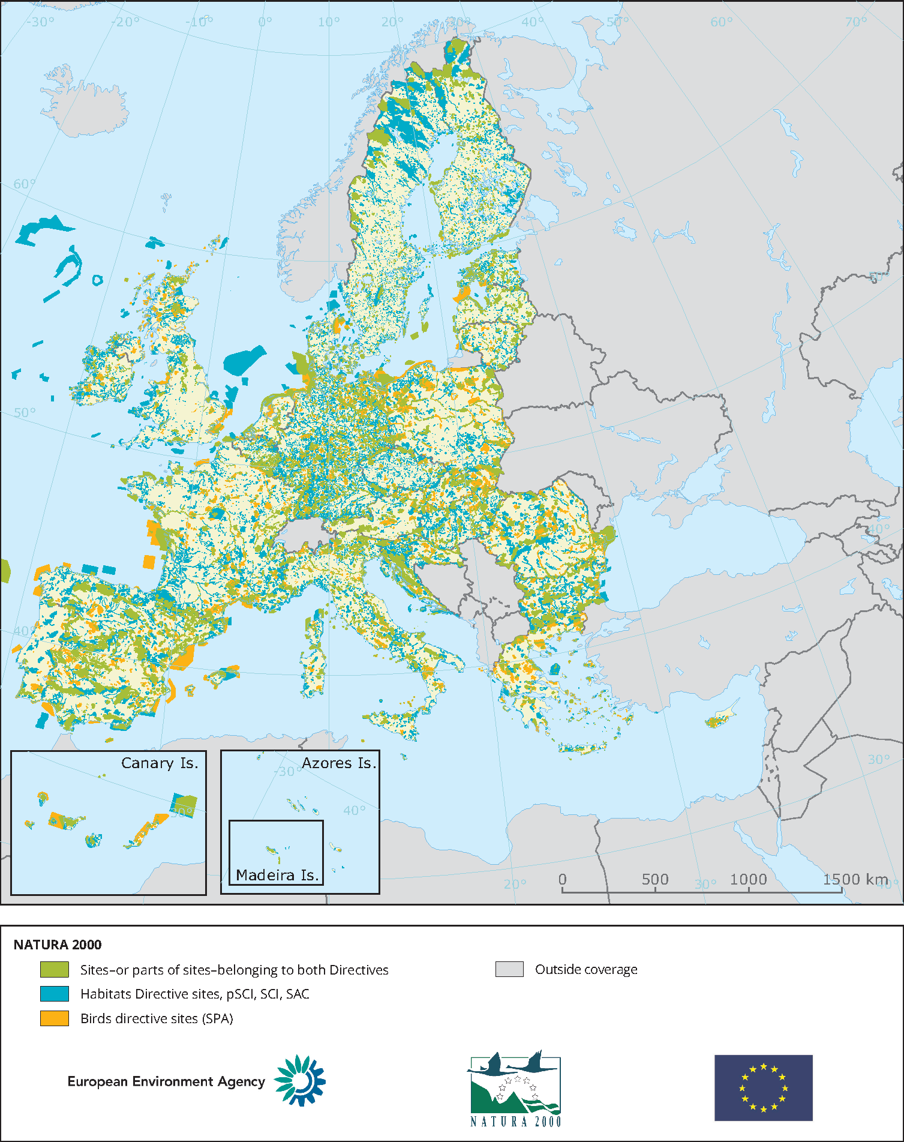
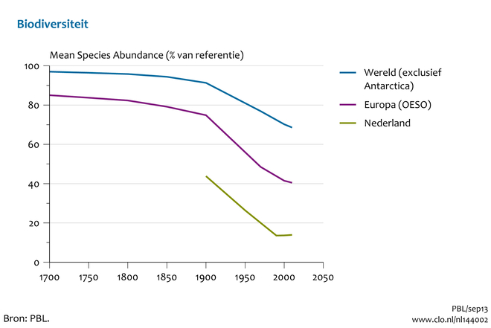
European Agreement: Nature Restoration

Slide 5
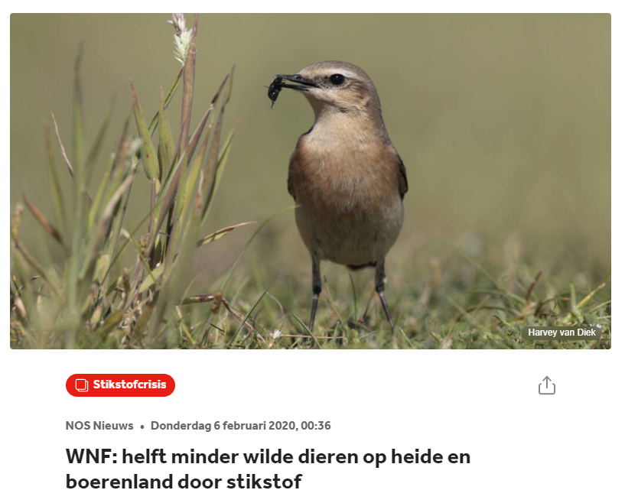
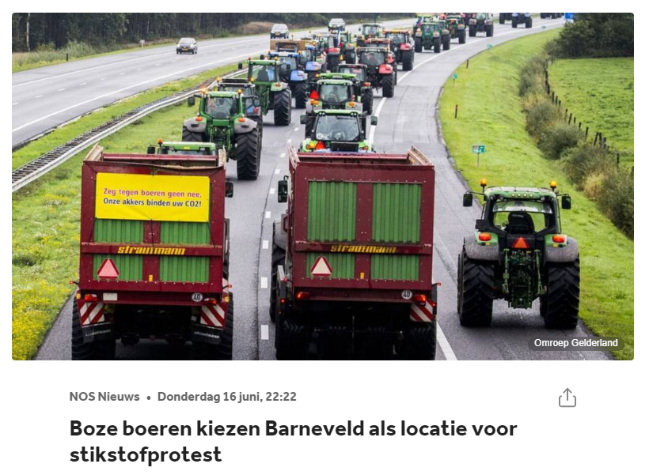
Nitrogen and Nature

Slide 6
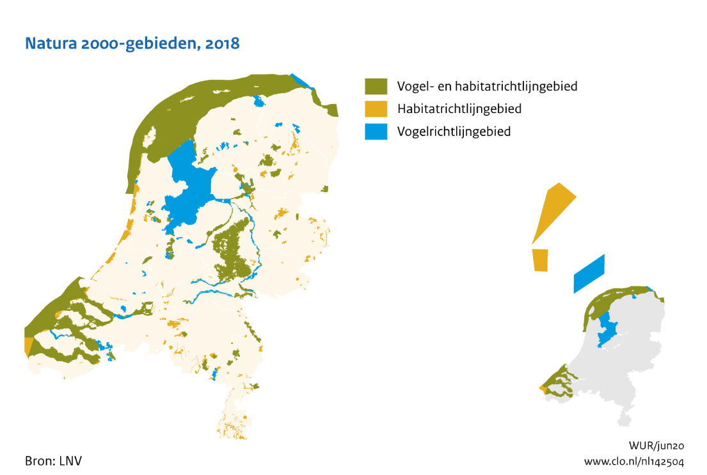
Monitoring Nature Restoration is complex
The basis for permits in Natura 2000 areas is grounded in a legal obligation to achieve results, covering 309,000 hectares of terrestrial nature. Fieldwork plays a critical role in this process, but it is influenced by the observer effect, and comprehensive monitoring is only conducted once every 12 years. Some areas are poorly accessible, and certain issues, like 'grassification,' are not structurally monitored.

Slide 7
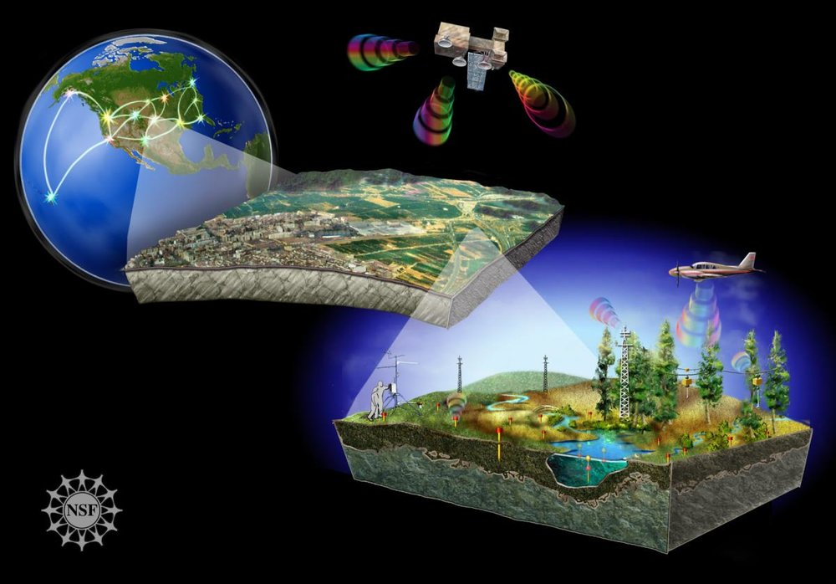
Business case
From a nature policy perspective, there is a need to explore whether remote sensing can support vegetation monitoring, where coverage, objective interpretation, and update frequency are becoming increasingly important.

Slide 8
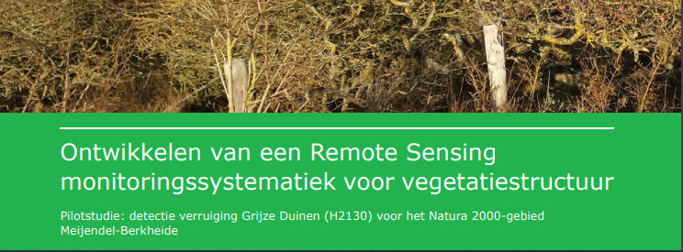
Research Question
Can satellite imagery help us monitor Natura-2000 areas?
So that, as a Province, we better understand our position and where we need to intervene.

Slide 9
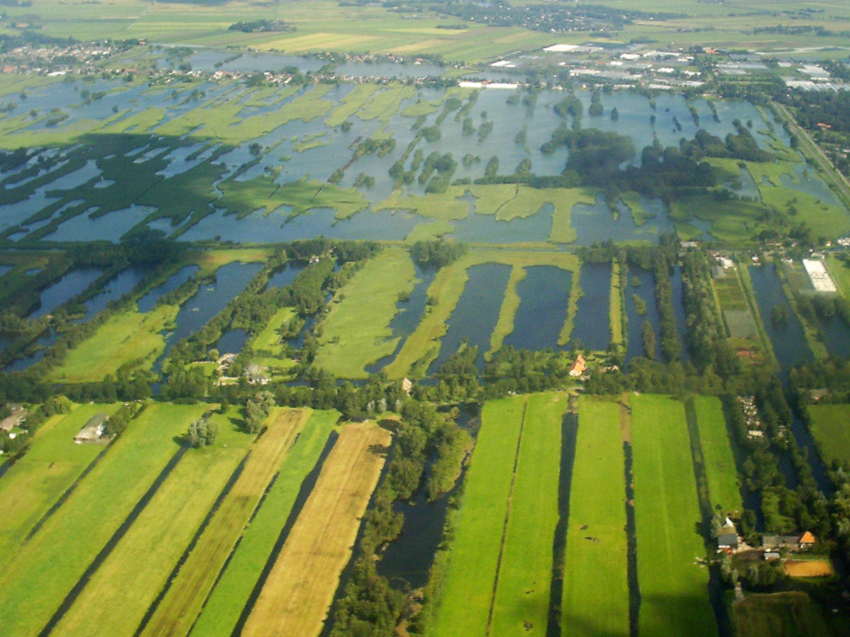
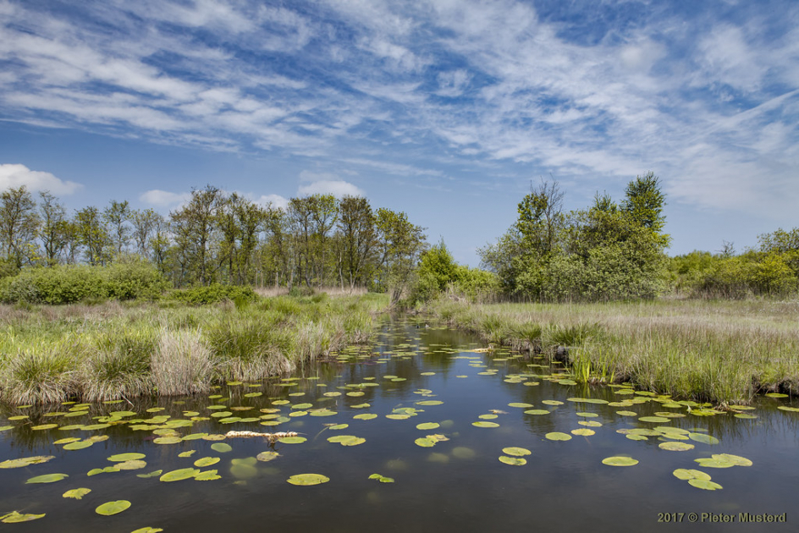
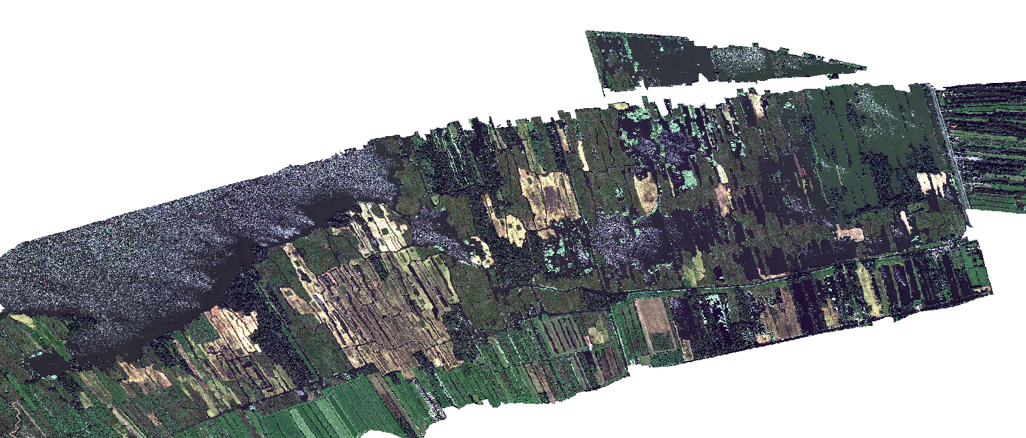
Can we monitor waterplants in Nieuwkoopse plassen?
Water plants are important for biodiversity and water quality.
Can we monitor them using satellite images?
For example, to determine if certain policies have been successful.
Sprint review 100
Dinsdag 9 Mei 2023
Notes:
Met meer banden lijkt het beter om gewassen te herkennen

Slide 10
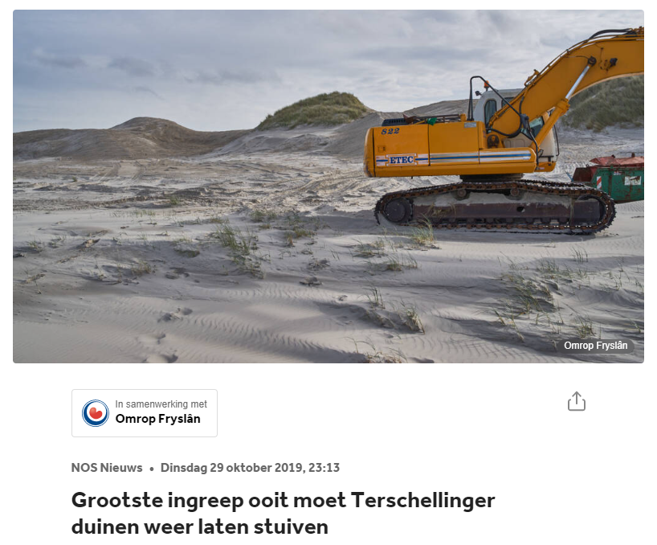
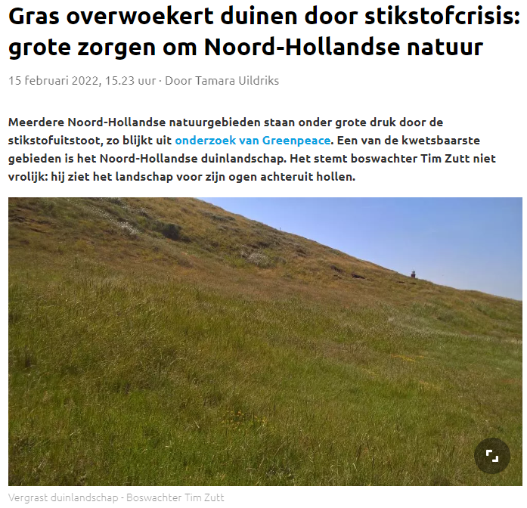
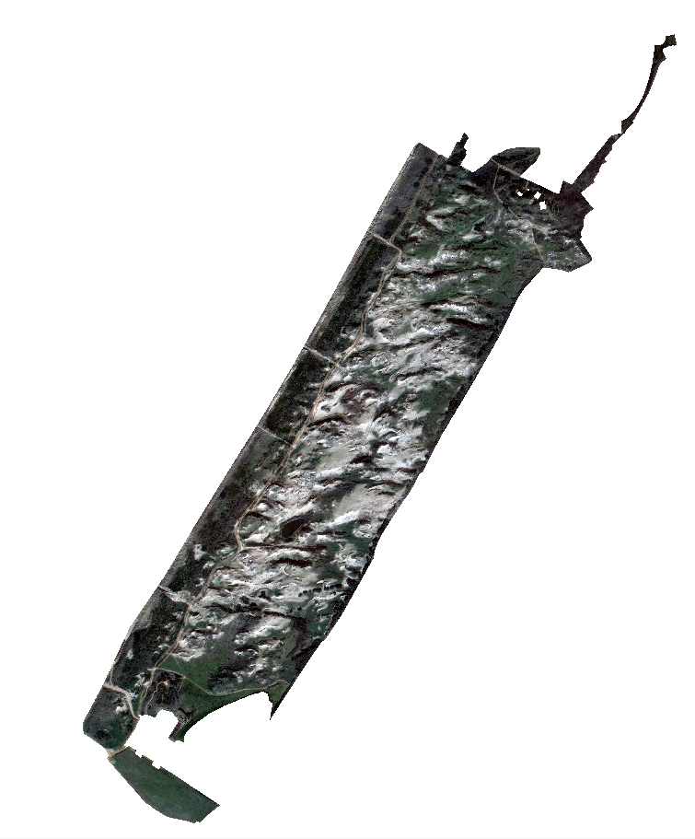
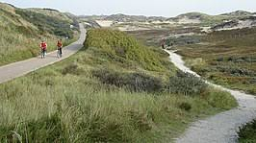
Grassification of Coepelduynen
Can we measure grassification of the Coepelduynen on satellite images?

Slide 11
Overview
Satellite imagery and machine learning
Lesson learned, a lot of annotations are important!

Slide 12
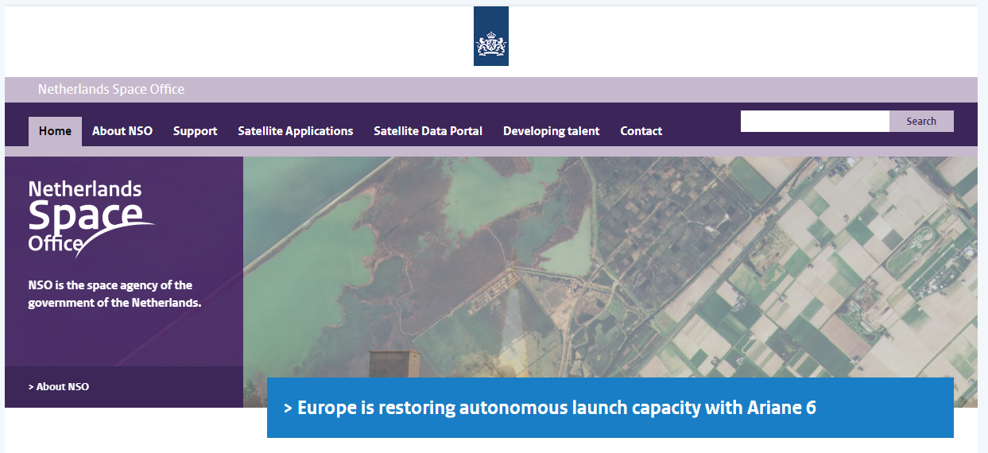

Slide 13
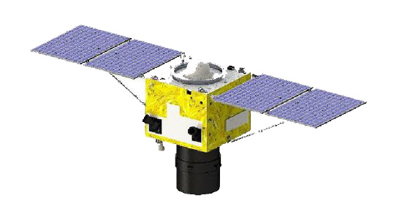

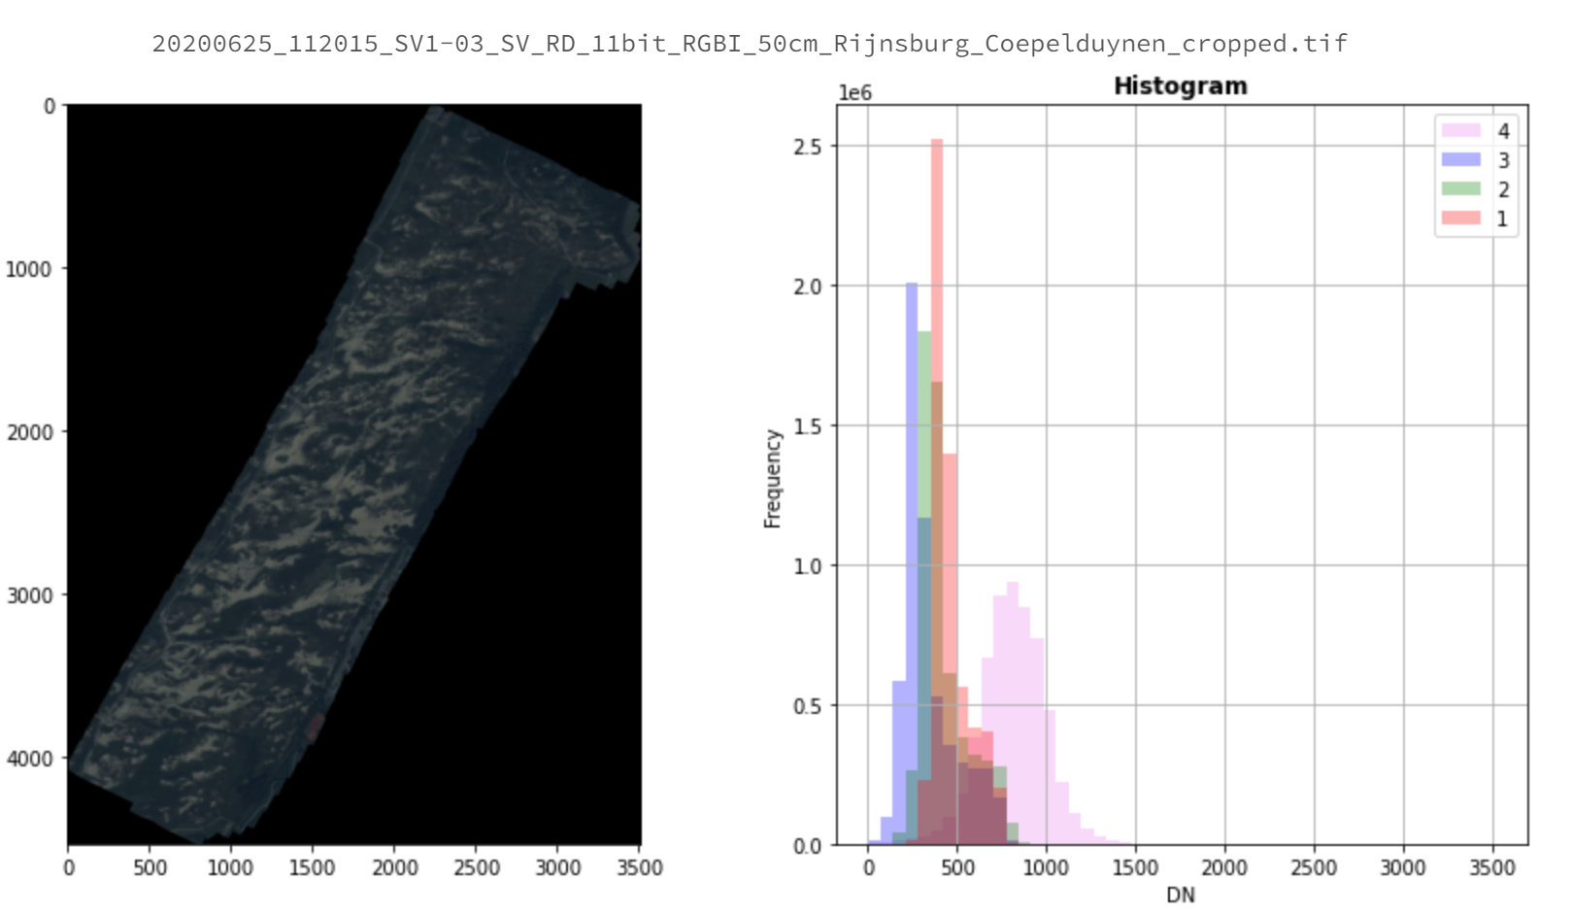
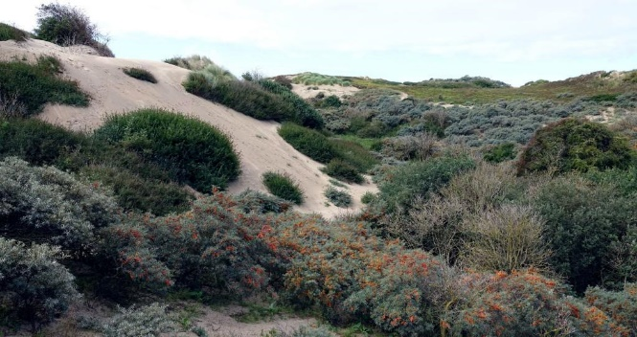
NSO Superview Satelliet data
Flies over the Netherlands every three months.
Provides RGBI data with a 50 cm resolution.
Freely available for Dutch citizens through the NSO (Netherlands Space Office).
2019 - 2022

Slide 14

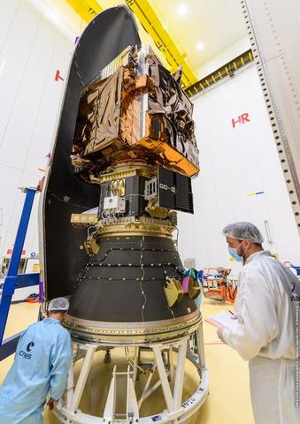
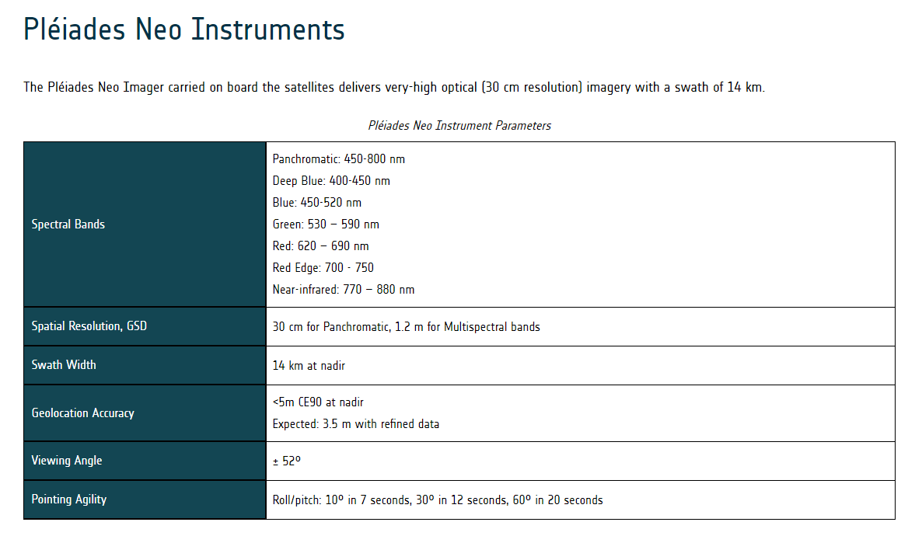
NSO Airbus Pleiades Neo
30 cm resolution instead of 50 cm resolution
Red, Green, Blue, Red Edge, Near-infrared
More stable images (limited number of images)
2023- onwards
Sprint review 100
Dinsdag 9 Mei 2023
Notes:
Met meer banden lijkt het beter om gewassen te herkennen

Slide 15
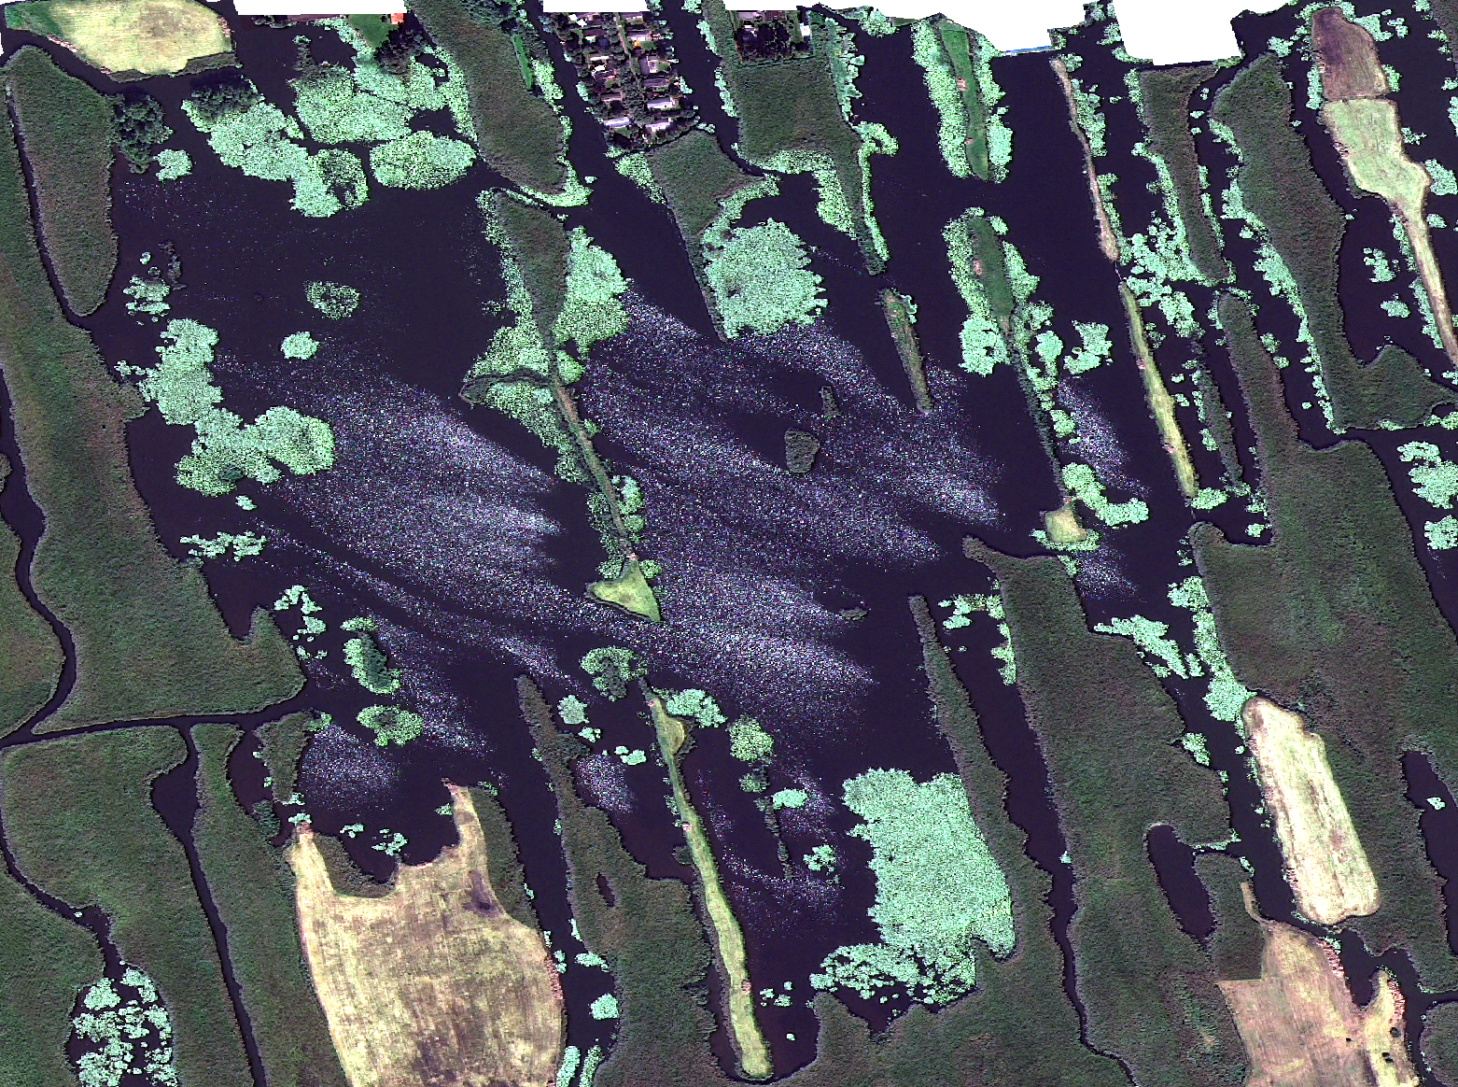
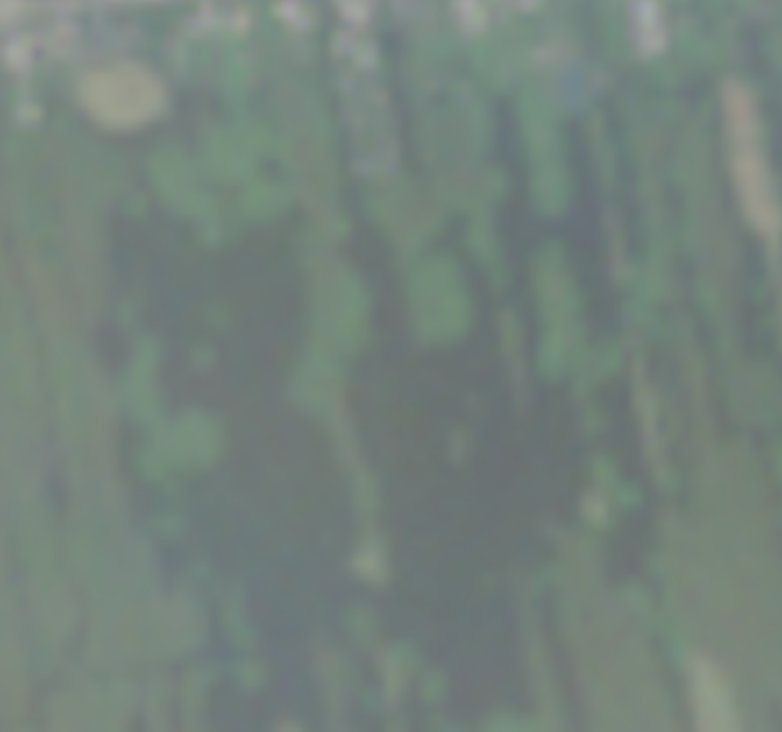
PNEO, 30cm
Sentinel 2, 10m
Sprint review 100
Dinsdag 9 Mei 2023
Notes:
Met meer banden lijkt het beter om gewassen te herkennen

Slide 16
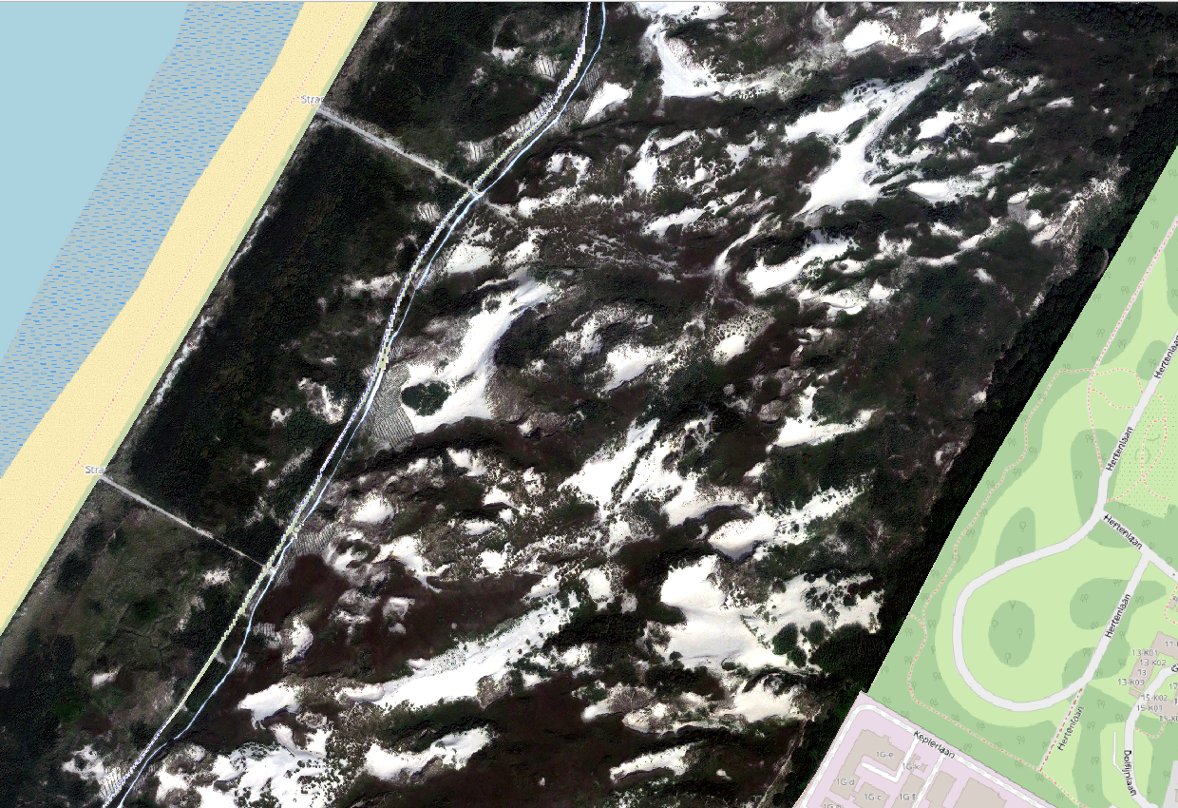
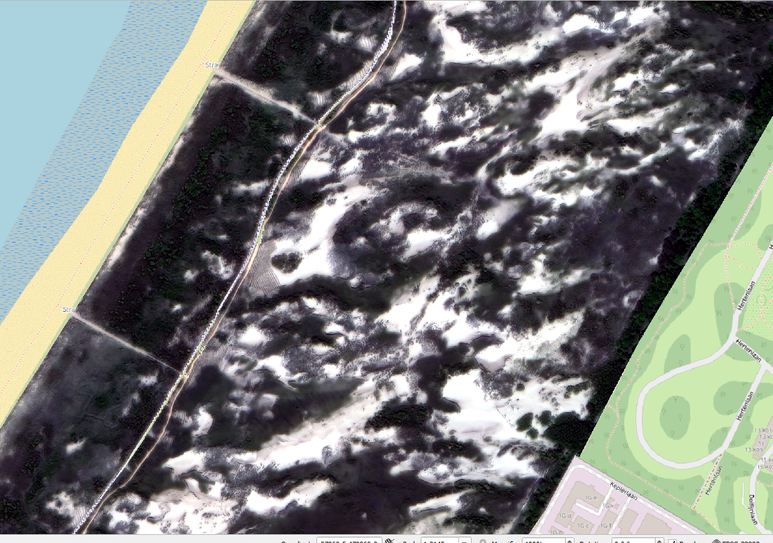
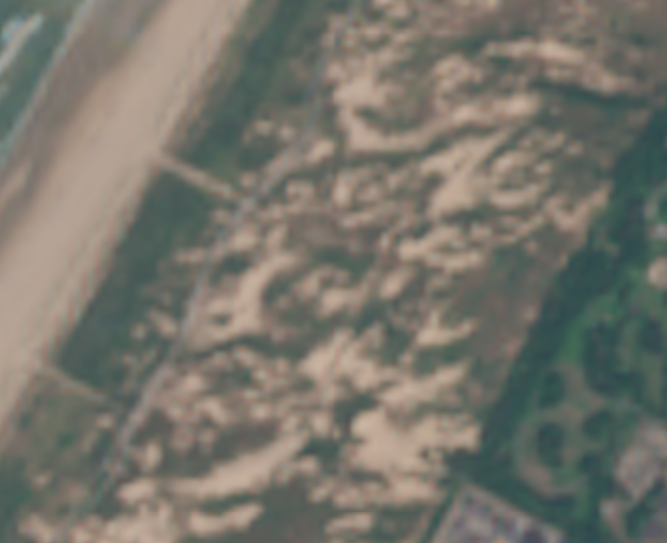
PNEO, 30cm
Superview, 50cm
Sentinel 2, 10m
Sprint review 100
Dinsdag 9 Mei 2023
Notes:
Met meer banden lijkt het beter om gewassen te herkennen

Slide 17
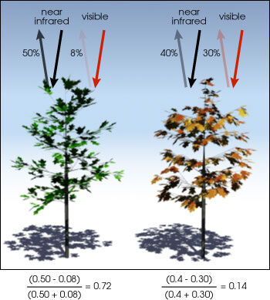
Normalised difference vegetation index

Slide 18
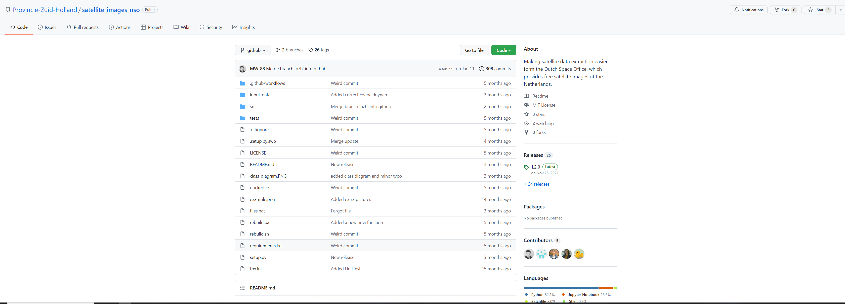

NSO api data extraction.
https://github.com/Provincie-Zuid-Holland/satellite_images_nso_extractor

Slide 19
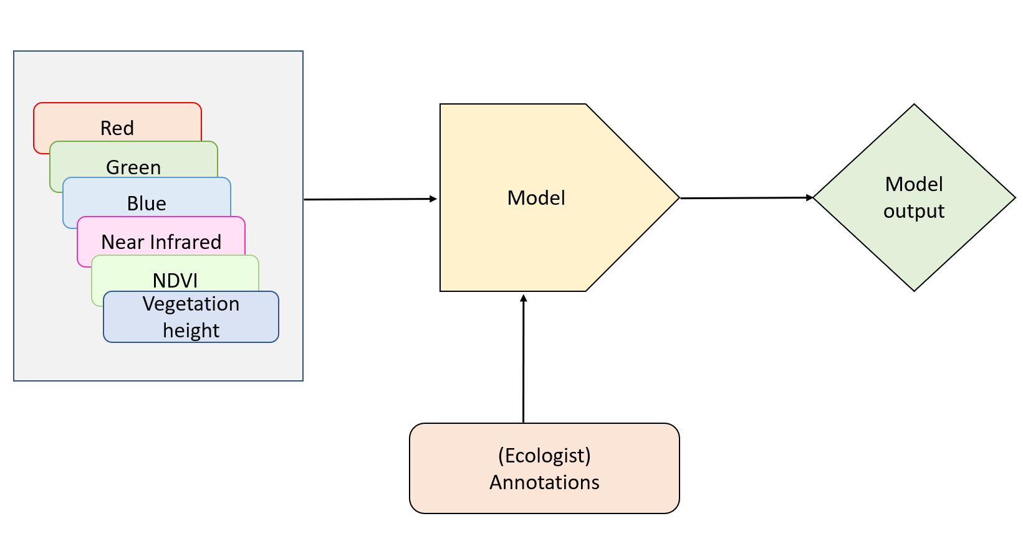
Pixel based Radom Forest Model
n_estimators 40 min_samples_split 15 min_samples_leaf 5 bootstrap True
https://github.com/Provincie-Zuid-Holland/satellite-images-nso-datascience
https://github.com/Provincie-Zuid-Holland/satellite_images_nso_tif_model_iterator

Slide 20
Pilot Schippersgat
Sprint review 100
Dinsdag 9 Mei 2023
Notes:
Met meer banden lijkt het beter om gewassen te herkennen

Slide 21
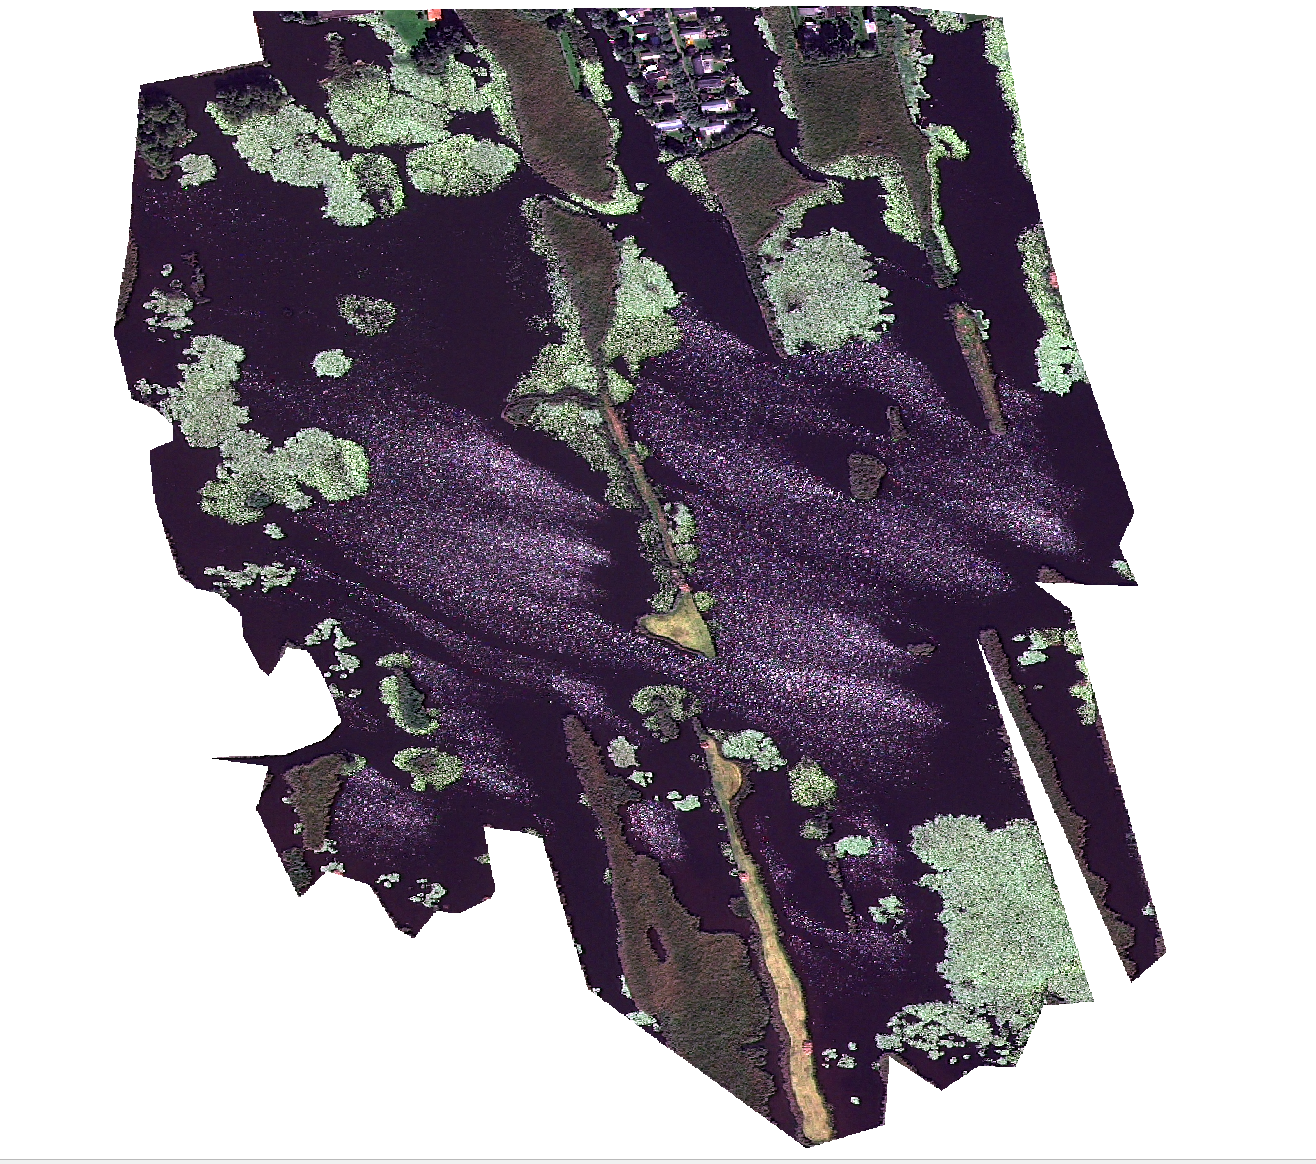
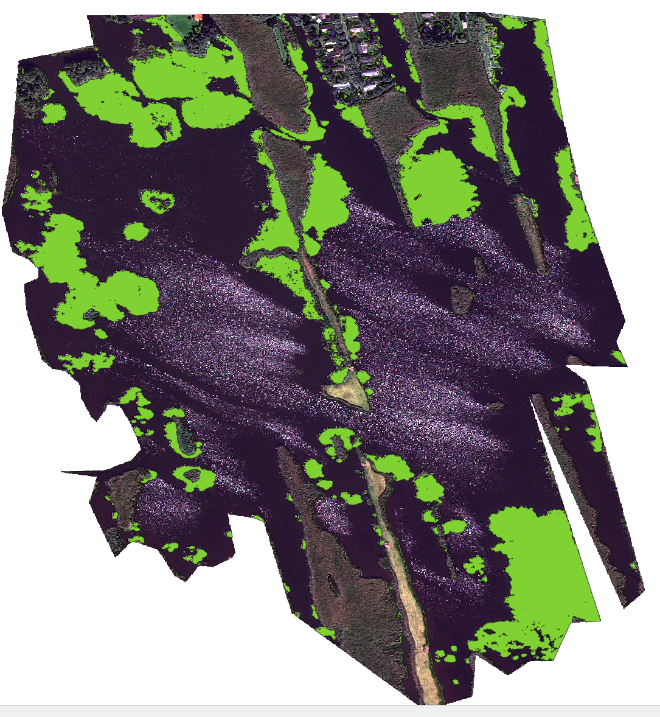
Pilot Schippersgat
2023-09-05
Sprint review 100
Dinsdag 9 Mei 2023
Notes:
Met meer banden lijkt het beter om gewassen te herkennen

Slide 22
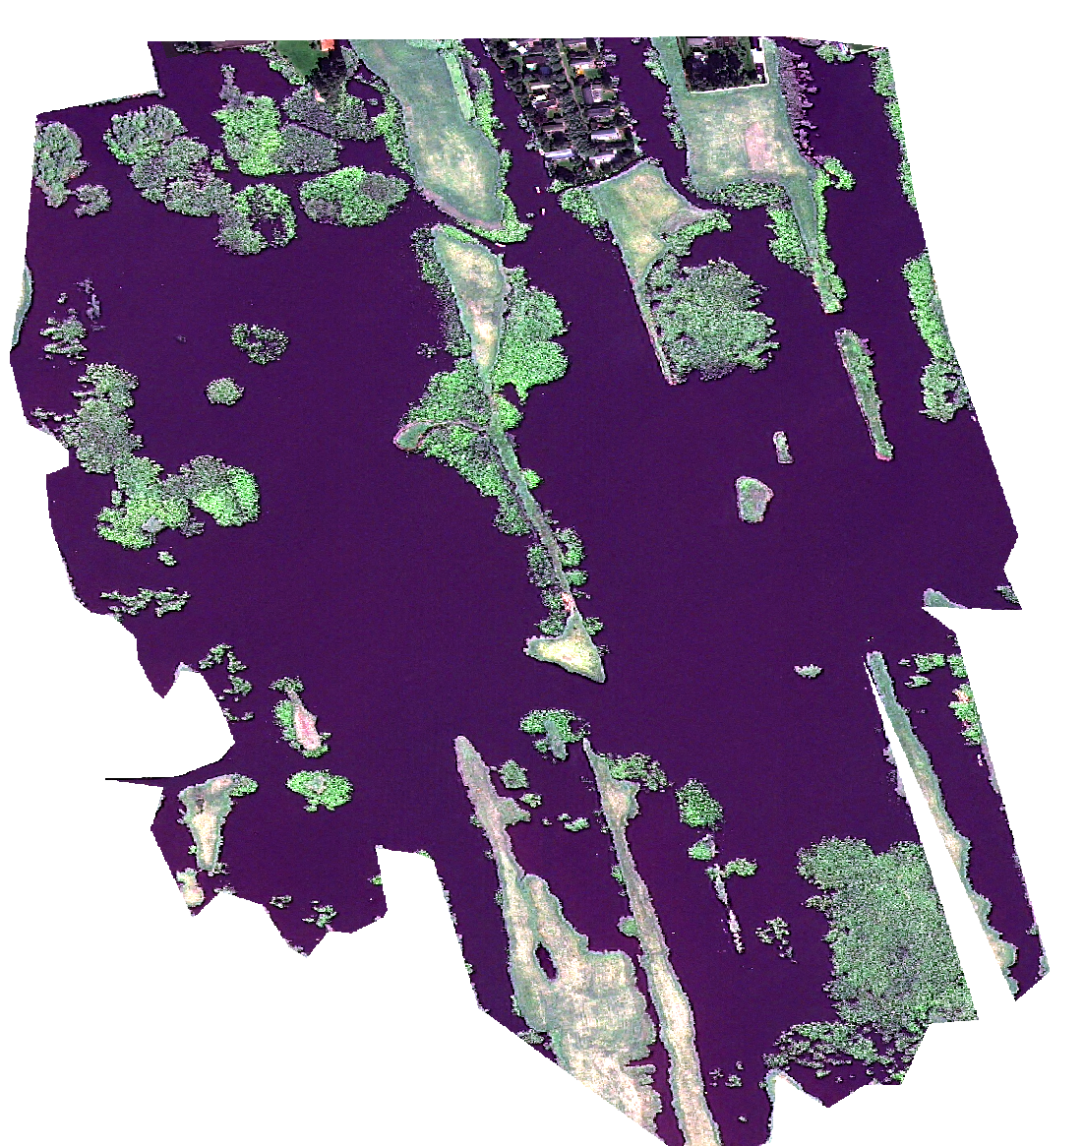
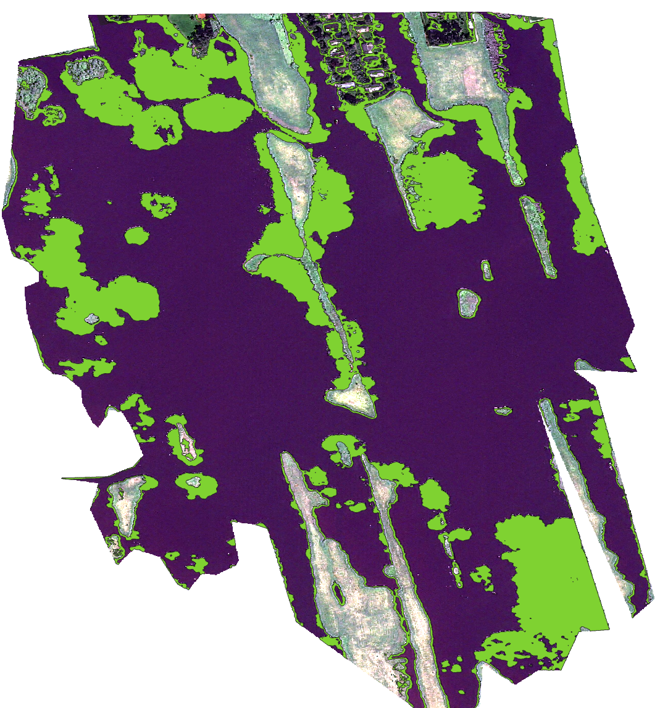
Pilot Schippersgat
2023-06-03
Sprint review 100
Dinsdag 9 Mei 2023
Notes:
Met meer banden lijkt het beter om gewassen te herkennen

Slide 23
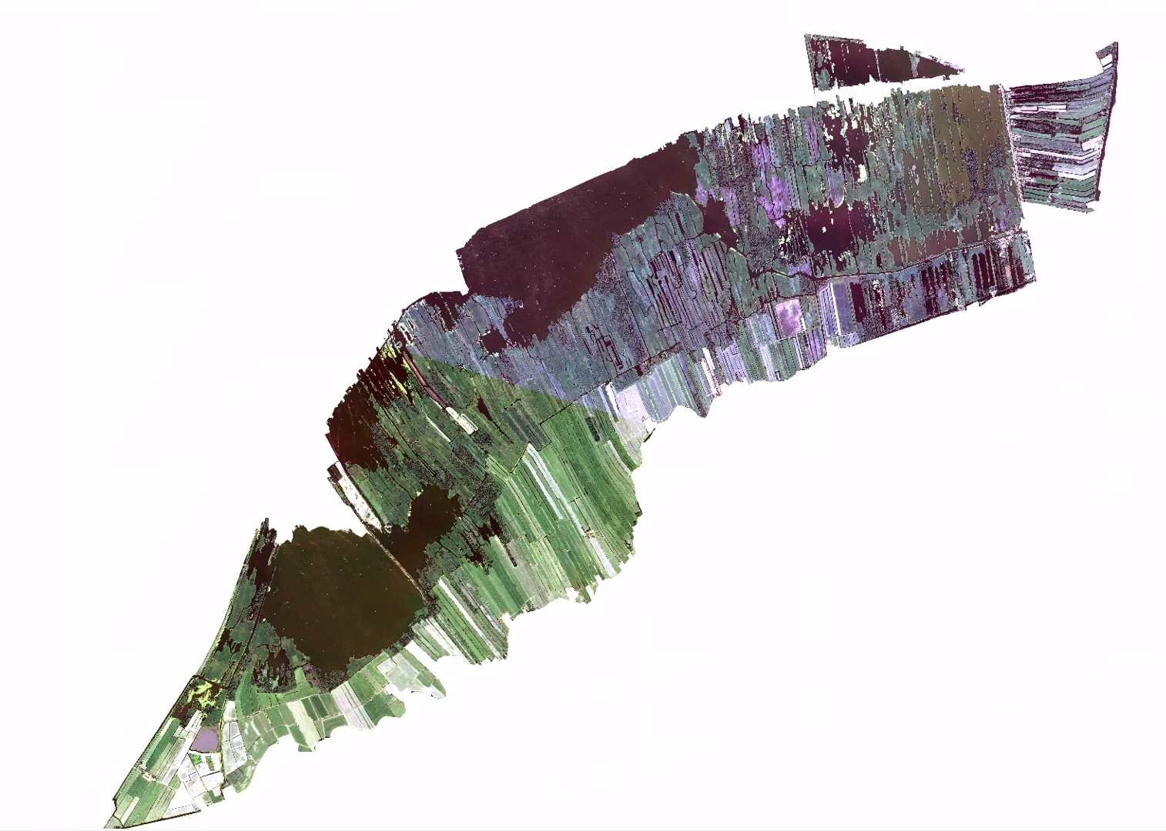
Merging Images
Region too large to always fit in one orbit of the satellite. Have to merge images
Sprint review 100
Dinsdag 9 Mei 2023
Notes:
Met meer banden lijkt het beter om gewassen te herkennen

Slide 24
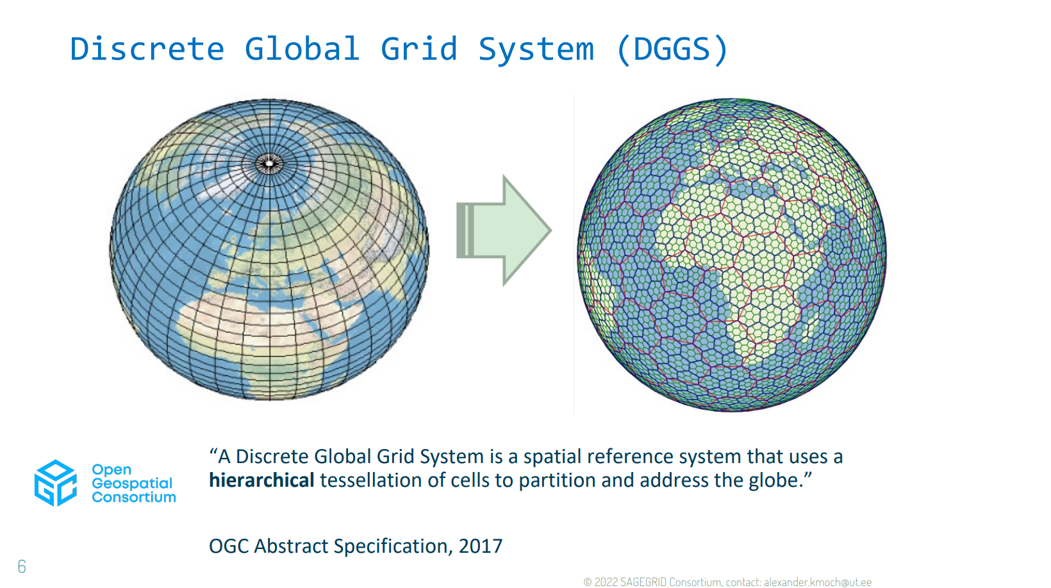
DGGS
Sprint review 100
Dinsdag 9 Mei 2023
Notes:
Met meer banden lijkt het beter om gewassen te herkennen

Slide 25
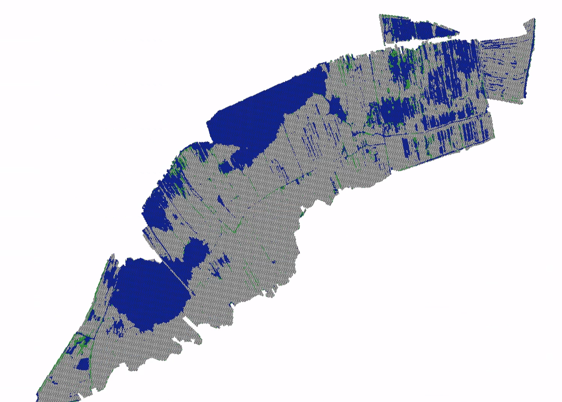
DGGS
Model accuracy high on annotations:
Ground, f1-score: 0.996,
Water, f1-score: 0.998
Waterplants, f1-score: 0.99
Sprint review 100
Dinsdag 9 Mei 2023
Notes:
Met meer banden lijkt het beter om gewassen te herkennen

Slide 26
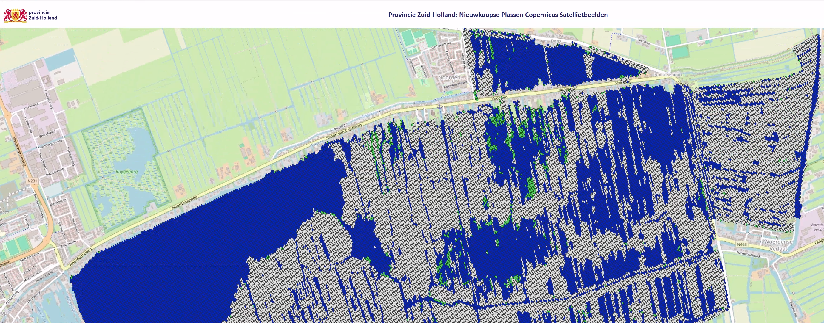
Viewer
Sprint review 100
Dinsdag 9 Mei 2023
Notes:
Met meer banden lijkt het beter om gewassen te herkennen

Slide 27
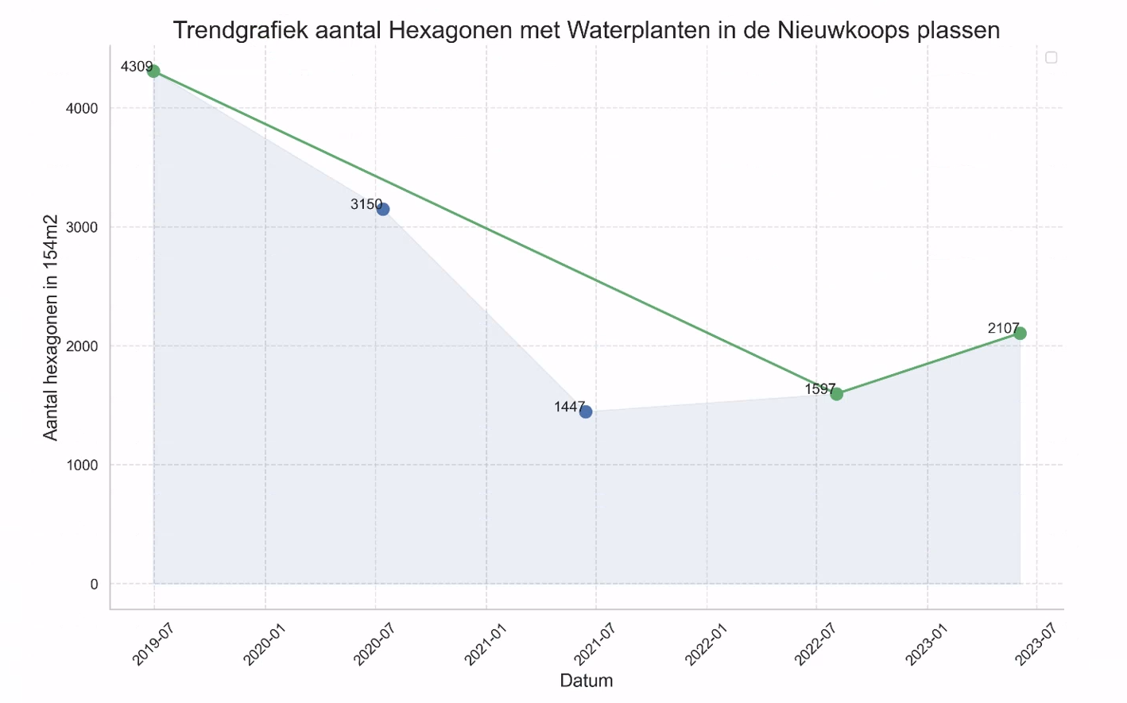
Results
Product
Downward trend in waterplants. This study supports that measures need to be taken to raise the waterplants population.
Sprint review 100
Dinsdag 9 Mei 2023
Notes:
Met meer banden lijkt het beter om gewassen te herkennen

Slide 28
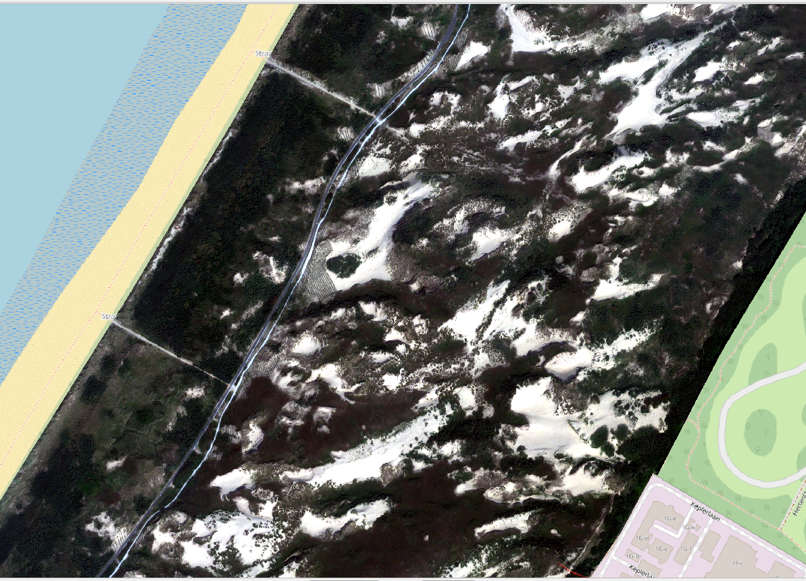
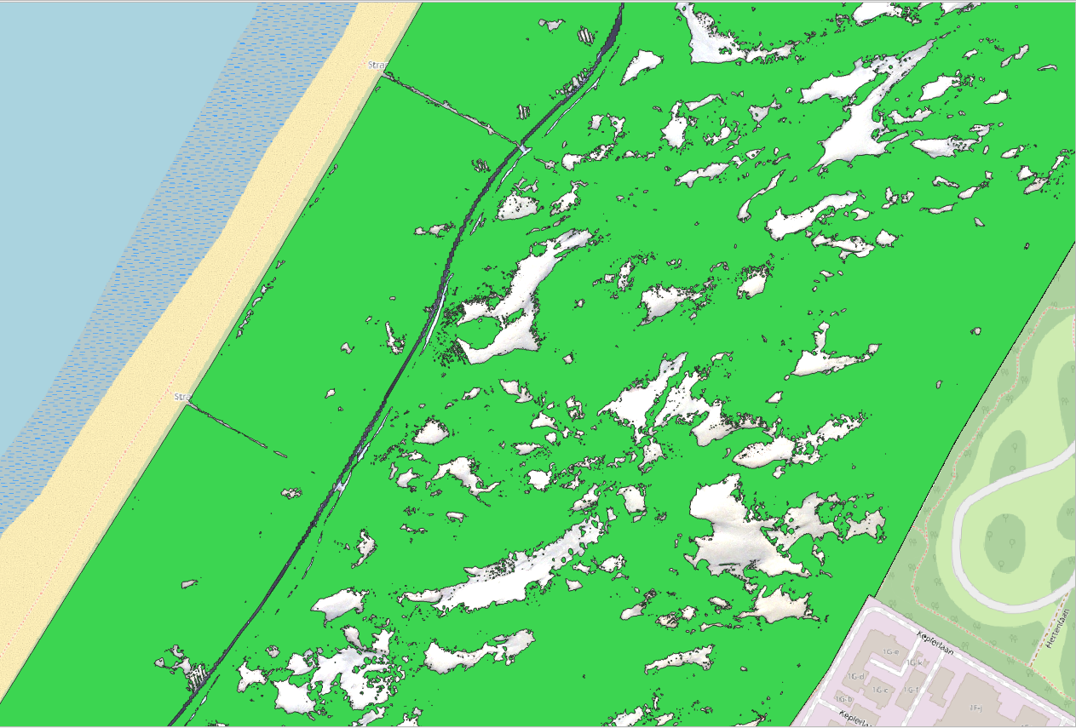
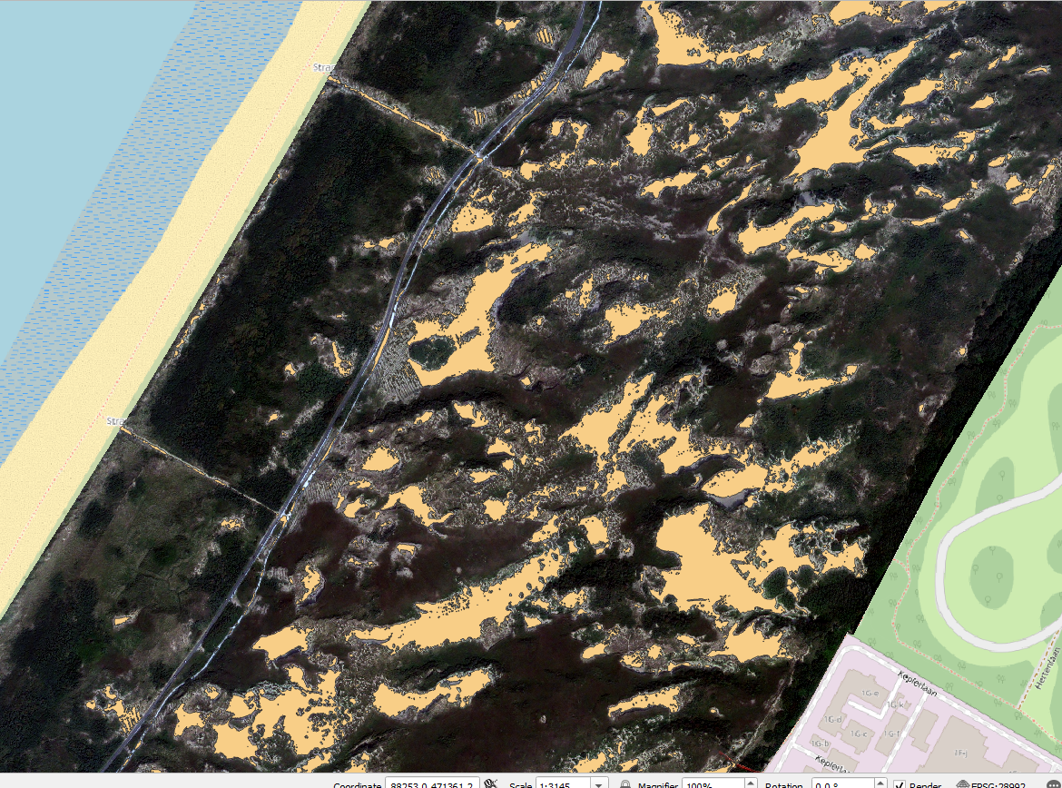
Results
Coepelduynen
Less is more
Source
Vegetation
Sand
Sprint review 100
Dinsdag 9 Mei 2023
Notes:
Met meer banden lijkt het beter om gewassen te herkennen

Slide 29
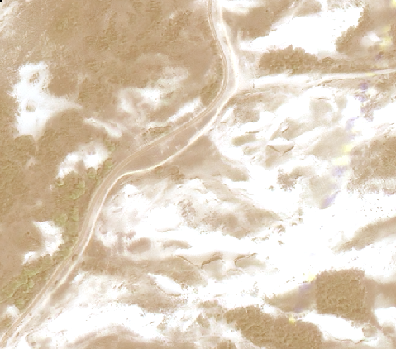
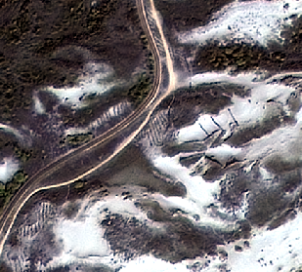
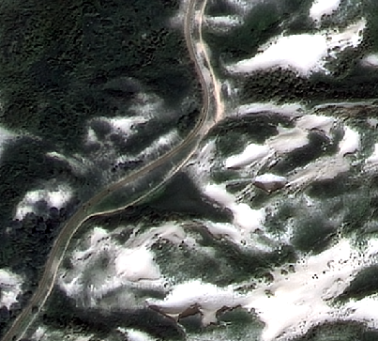
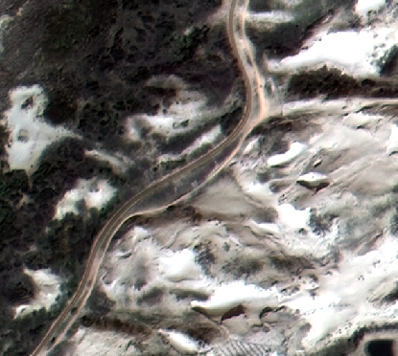
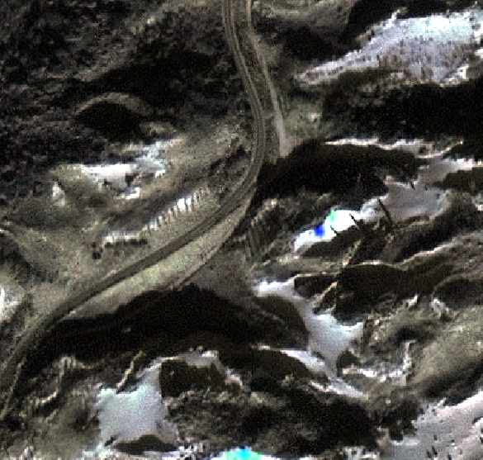
Data Colour Quality Superview not the best
Model needs a lot of annotations for this

Slide 30
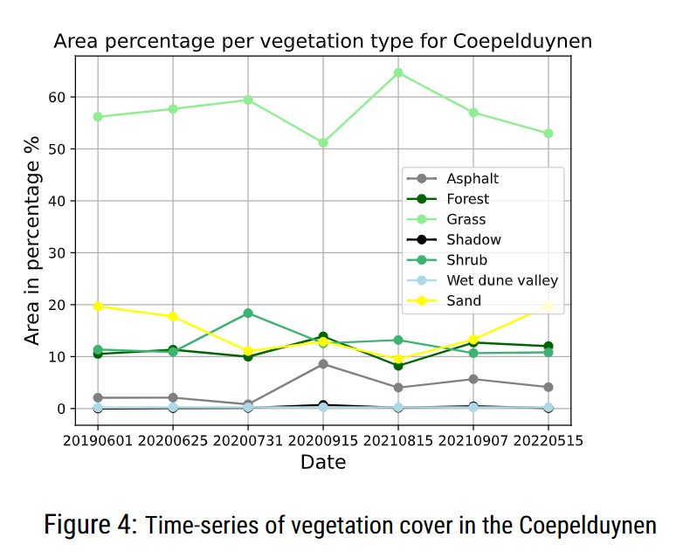
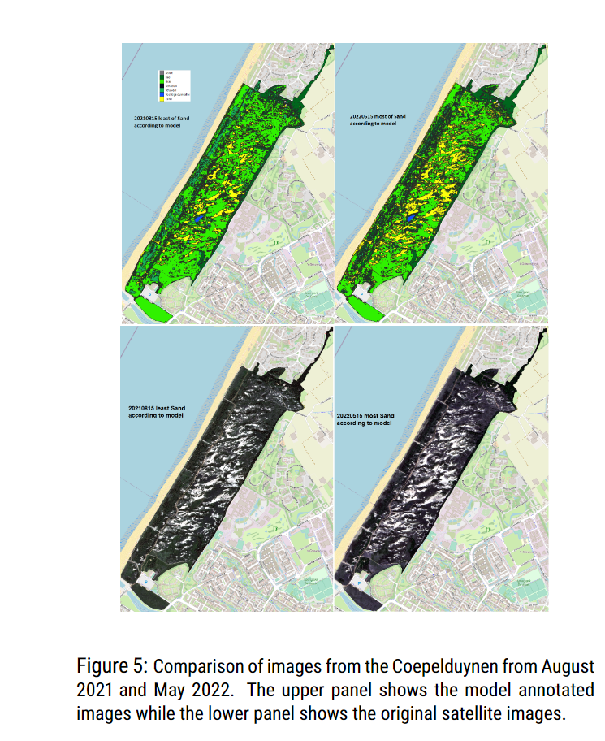
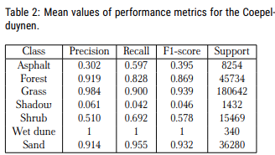
Results Trendgraph

Slide 31
Conclusion
-Clouds can cause interference over larger regions, making it difficult to obtain seasonal data within a single year.
-A significant amount of manual annotation is required for a good model.
-Satellite imagery does not replace other methods but rather complements measurements such as drones, aerial photos, and field studies.

Slide 32
Maatwerk model Resultaten op oog
2019-04-22

Slide 33
Maatwerk model Resultaten op oog
2020-03-26

Slide 34
Maatwerk model Resultaten op oog
2020-06-25

Slide 35
Maatwerk model Resultaten op oog
2021-09-07

Slide 36

Maatwerk model Resultaten op oog
2021-09-07

